Slide 1
Semantic elemements

Slide 2
Semantic elements = elements with a meaning.
A semantic element clearly describes its meaning to both the browser and the developer.
Examples of non-semantic elements: <div> and <span> - Tells nothing about its content.
Examples of semantic elements: <form>, <table>, and <article> - Clearly defines its content.

Slide 3
In HTML there are some semantic elements that can be used to define different parts of a web page:
<article>
<aside>
<details>
<figcaption>
<figure>
<footer>
<header>
<main>
<mark>
<nav>
<section>
<summary>
<time>

Slide 4
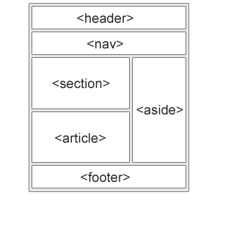

Slide 5
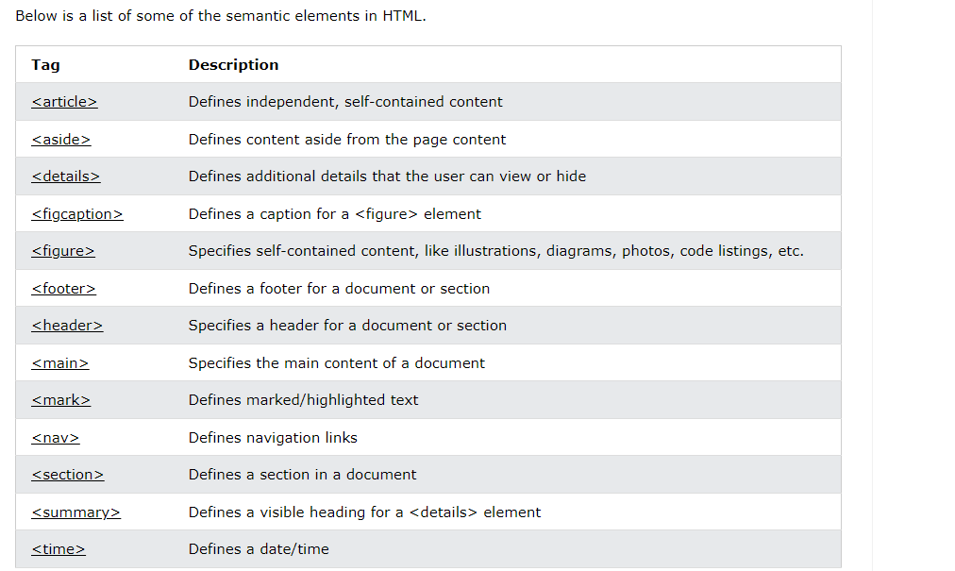

Slide 6
HTML Favicon
A favicon is a small image displayed next to the page title in the browser tab.
<link rel="icon" type="image/x-icon" href=“favicon.ico">

Slide 7
HTML TABLES
A table in HTML consists of table cells inside rows and columns.
<table>
<tr>
<td>Emil</td>
<td>Tobias</td>
<td>Linus</td>
</tr>
<tr>
<td>16</td>
<td>14</td>
<td>10</td>
</tr>
</table>

